Slide 1
WHAT IS AWS LAMBDA ?
AWS Lambda is an event driven serverless function as a service provided by amazon as a part of Amazon Web Services . It is designed to enable developers to run code without provisioning or managing servers . It executes code in response to events and automatically manages the computing resources required by that code .

Slide 2
AWS LAMBDA KEY FEATURES
Event driven execution .
There is a automatic scale based on numbers .
There is a billing after a month usage .
There are a short lived tasks .

Slide 3
how to create an AWS Lambda
Step 1 : Open the Lambda Console .
THEN SIGN TO THE AWS MANAGEMENT CONSOLE
FROM SERVICES -> Compute -> Lambda , click the bright Create function button .
Be sure that you are the right region lm=ammbda is region-asia pacific(Mumbai).
Step 2: Author from scratch
Choose Author from scratch.
Enter a name (Demofunction).
Pick a runtime like node.js 22.x or python 3.6
Leave architecture onx86_64.
Click Create function to proceed .

Slide 4
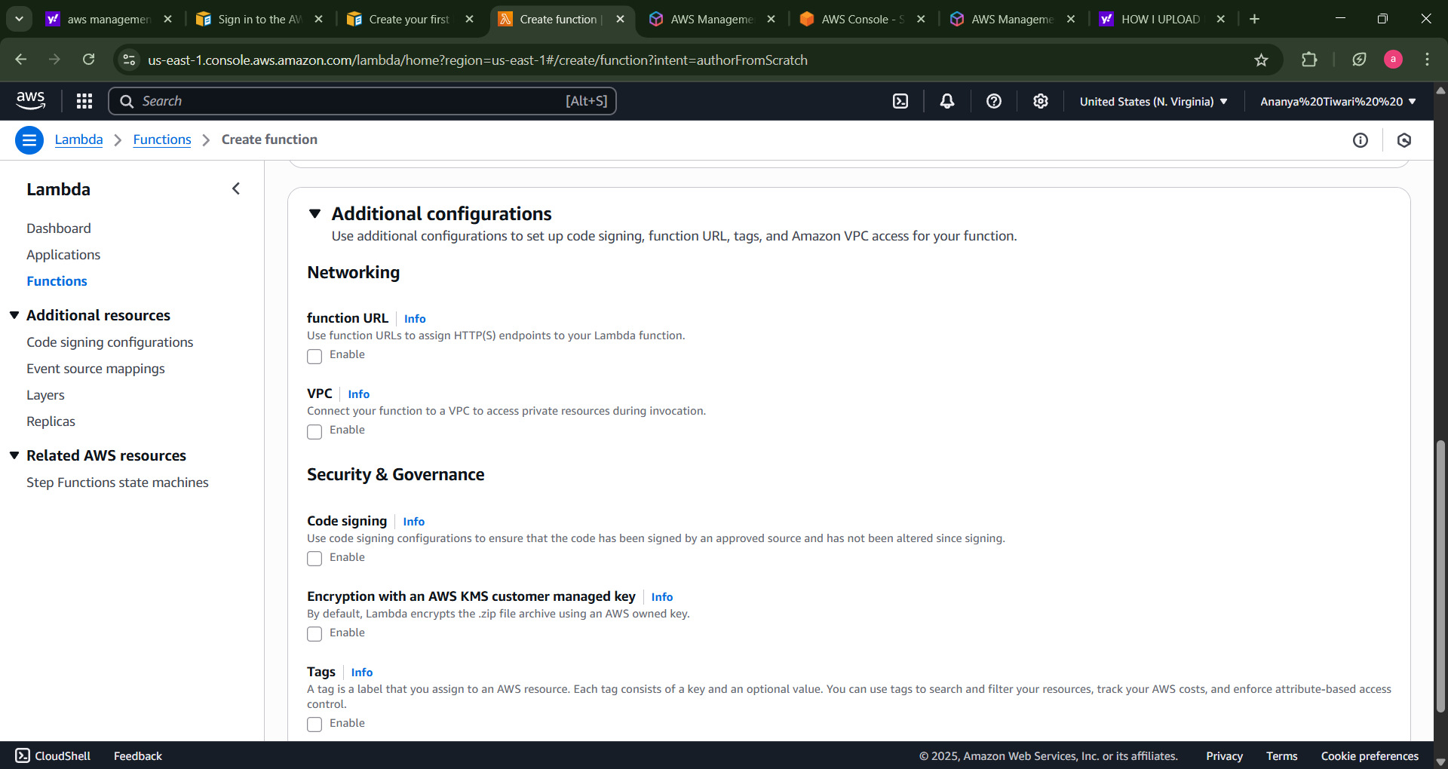
How to create a function ?
There are following steps mentioned below to create a function in the aws management console for lambda to create a function .

Slide 5
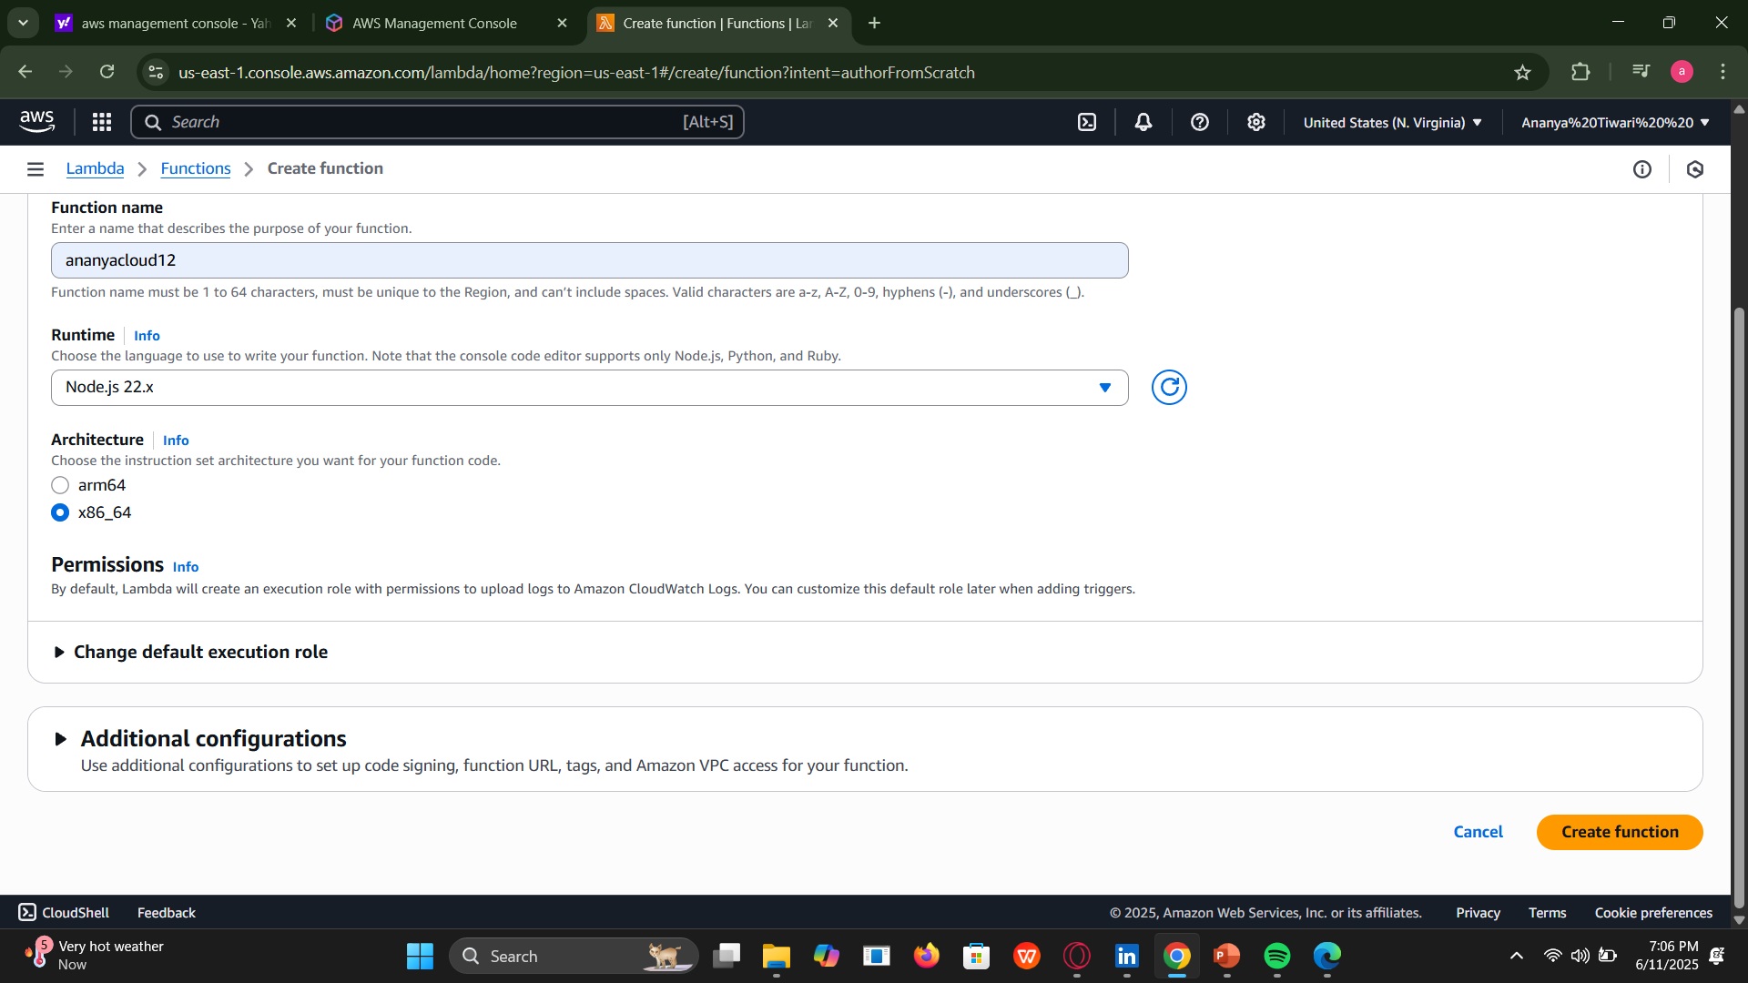
Then go the function name to and fill the above information and select the create function .

Slide 6
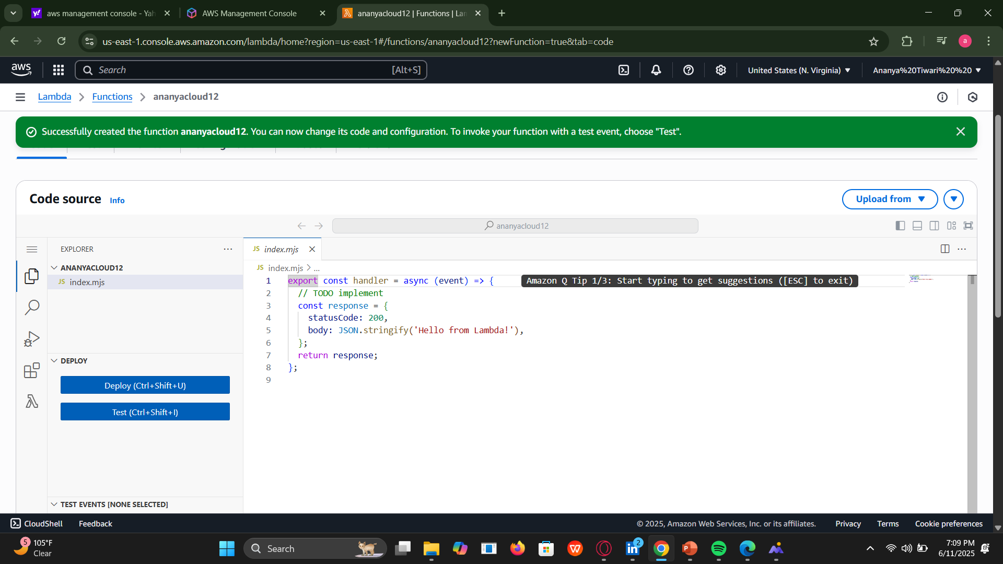
NOW how to deploy THAT FUNCTION ?
TO DEPLOY THAT FUCTION SEE THE LEFT SIDE BAR TO DEPLOY THAT
THERE WILL BE TWO OPTION BE THERE DEPLOY AND TEST .
THEN FROM THERE WILL BE THE CODE BE DEPLOYED .

